Slide 1
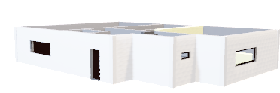
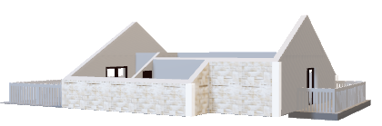
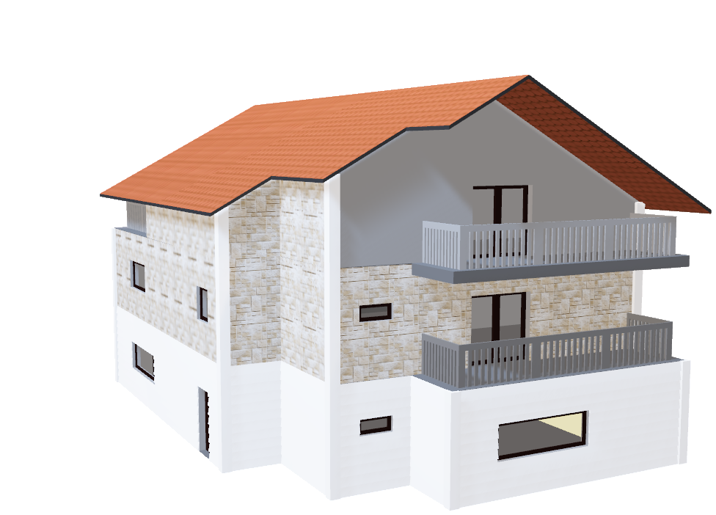
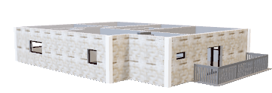
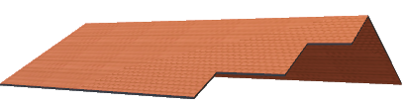
BA 280 – ADVANCED DATA ANALYSIS – ADRIANA SILVEIRA
KAGGLE – PREDICT HOUSE PRICES

Slide 2
Purpose of the work
Based on the Kaggle Ames Housing Dataset create a regression model to predict house prices.
The goal is to create a model with 80% of accuracy at least.
Among 79 different attributes, what are the ones that most explain a house sale price?

Slide 3
Regression Excel
I found that the following attributes create a regression model with a R² = 0.7848.
LotArea
OverallQual
OverallCond
YearBuilt
YearRemodAdd
TotalBsmtSF
GrLivArea
Fireplaces
GarageCars

Slide 4
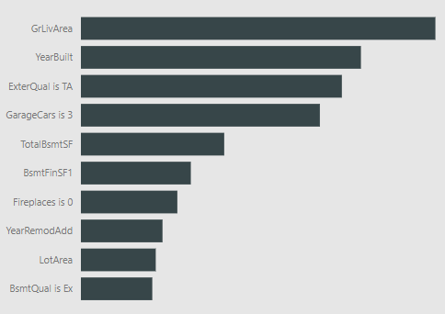
Regression PowerBI
In PowerBI I got a better prediction model with 85% in Performance. The main predictors found are:

